Slide 1
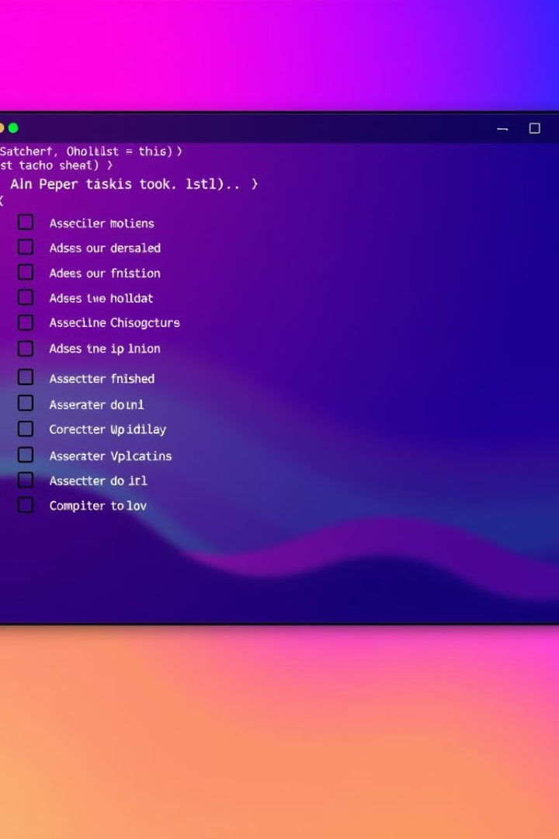
Simple To-Do List in Bash
202401040319 : Yashraj Ghule
202401040283 : Shreyas Yadav
202401040124 : Tejas Jaju

Slide 2
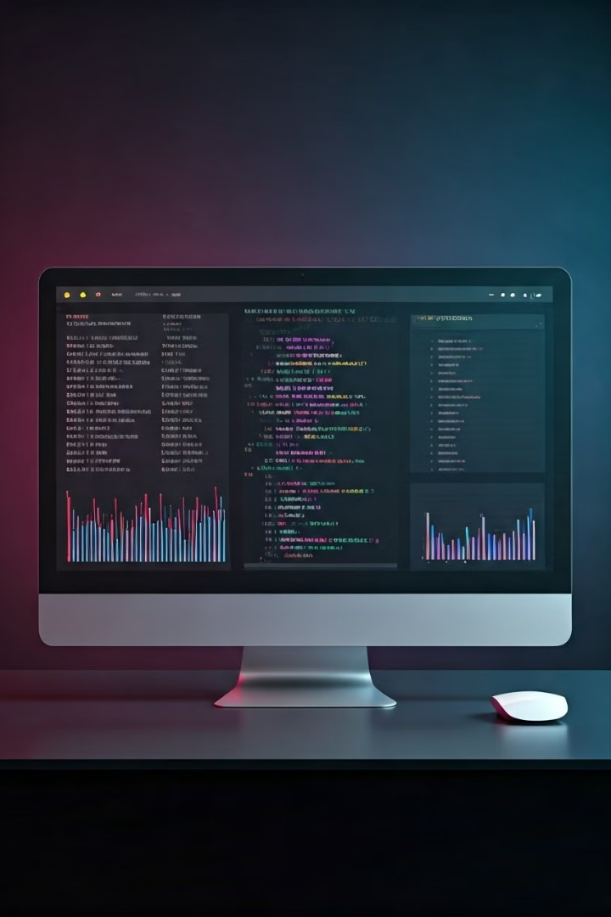
Simple To-Do List in Bash
Add, View, Complete Tasks
This Bash script offers a straightforward command-line interface for managing your tasks.
Command-Line Interface
Key features include adding, viewing, and marking tasks as complete.

Slide 3



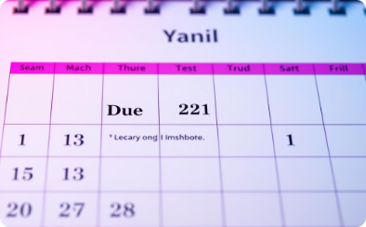
Project Workflow
Add Tasks
View Tasks
Complete Tasks
Due Dates
Use the create_task option to add a task. The script will prompt for the task name and a due date
Example:
Task: Complete project
Due Date: 2025-01-10 12:00
Use view_completed to see completed tasks and view_incomplete for pending tasks.
Completed tasks are marked "Completed," while incomplete tasks show the due date, status, and overdue flag.
Use the mark_completed option and provide the task number to mark a task as completed.
Example:
Task: Task 2 marked as completed!
You can specify a due date when adding tasks. The script validates the date and checks if tasks are overdue.
Use view_incomplete to see tasks with due dates and view_completed for completed tasks with date

Slide 4
Important Bash Commands Used in the Code
grep
cut
date
Searches for patterns in files, used to find specific tasks or statuses.
Splits strings based on delimiters, used to extract specific parts of data (e.g., year, month).
Handles and formats dates/times for task due dates and current time.
sed
touch
Edits text in files, used for updating task statuses.
Creates empty files, used to create the tasks file if it doesn't exist.

Slide 5
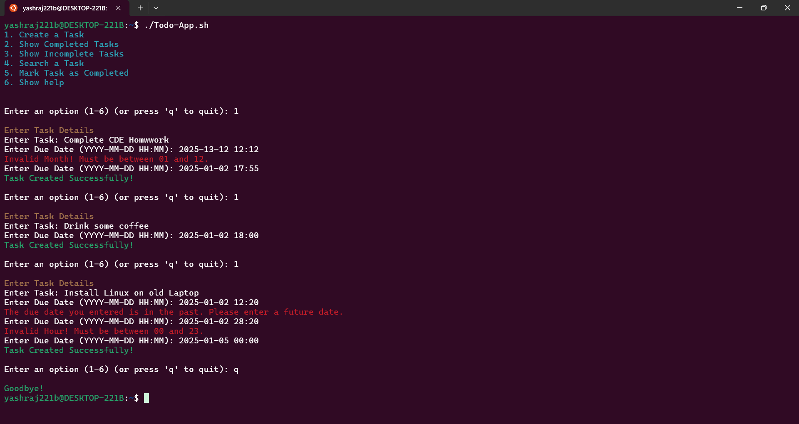
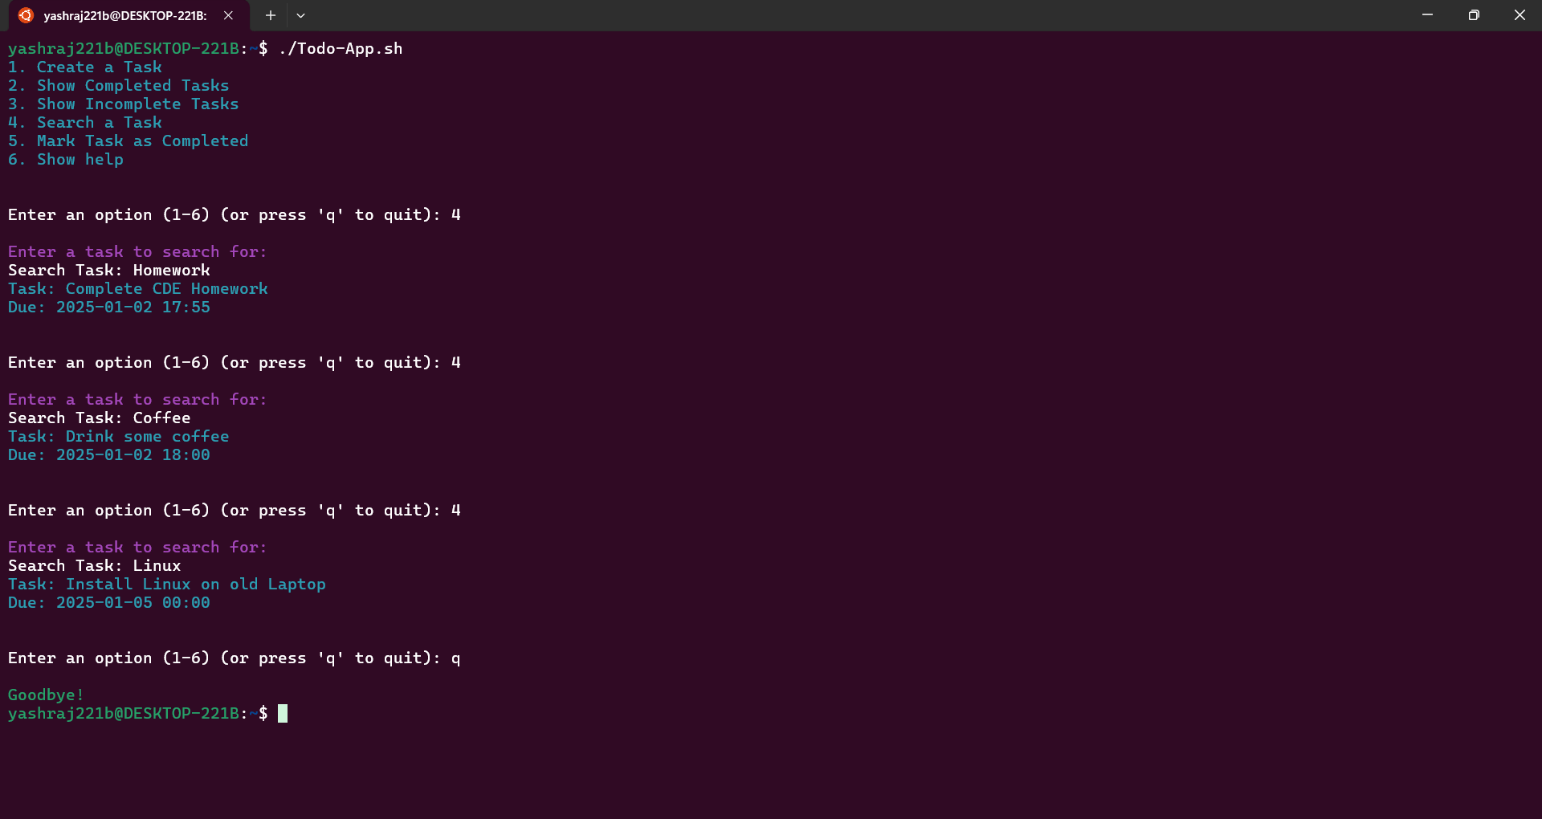
Output

Slide 6
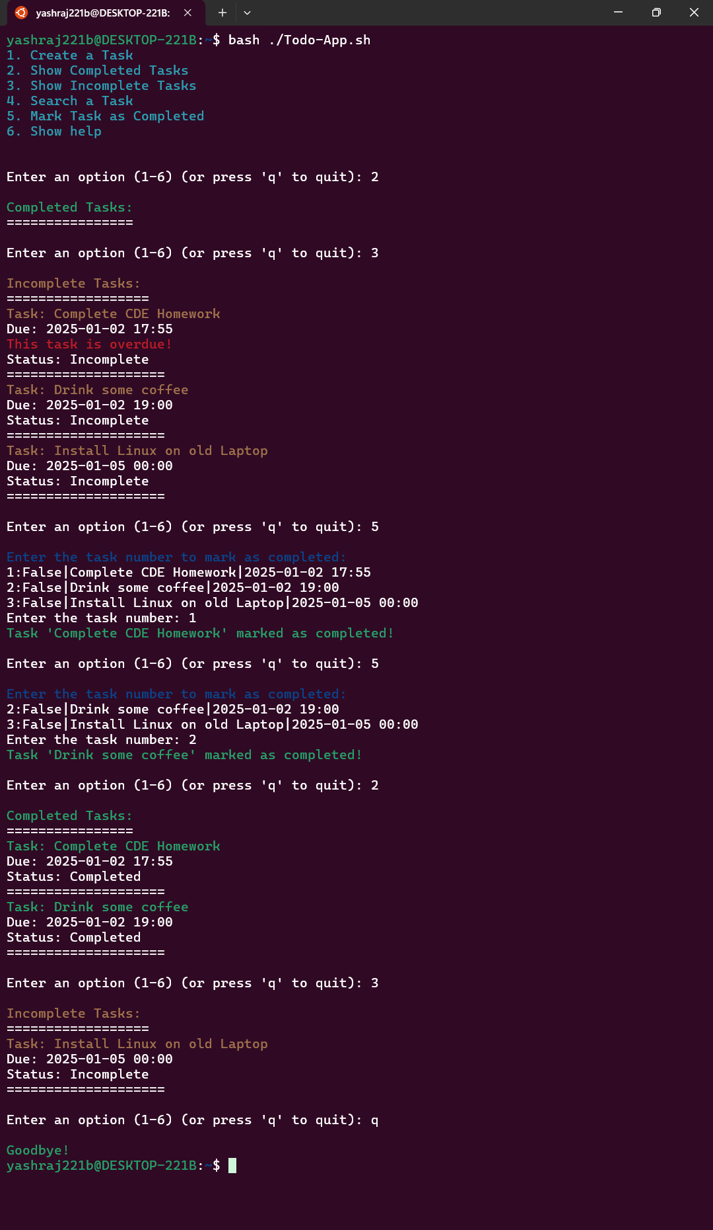
Output

Slide 7



Use of Project
Quick task management
Learn Bash basics
For terminal users
Through practical example

Slide 8

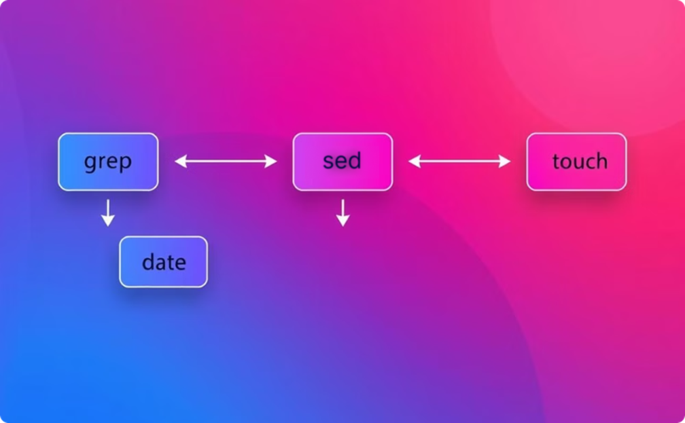
Result and Conclusion
Functional Bash To-Do List
Effective Data Handling
This project successfully delivers a functional command-line to-do list application written in Bash. Users can add, view, and complete tasks efficiently.
The script efficiently manages task data, leveraging Bash commands like `grep`, `cut`, `date`, `sed`, and `touch` for seamless user input and data manipulation.

